Slide 1
TIER Campus Success Program
Face-to-Face Collaboration
© 2018 Internet2

Slide 2
TIER Campus Success Program
AGENDA
Welcome
Support Services Model Updates
TIER Working Group Chair & Subject Matter Expert report outs
CSP Working Group report outs
CSP Working Group breakouts
Closing

Slide 3
Welcome
10 minutes
Thank you!
Opening remarks
Quick Intros
Goals and desired outcomes
Provide very high level overview of all that’s going on
Get your questions answered!
Finalize what we have to complete by TechEx

Slide 4
Support Services Model Working Group
Michael D. Erickson
Colorado School of Mines
20 minutes

Slide 5

Support Services Model Working Group
Overview/mission of the Working Group
Identify a mechanism for collaborative engagement with vendors for development and support (immediate/short-term)
Draft a framework for continuing (sustained) development, addressing scope, participation and governance, and perhaps funding
Draft a framework for continuing (sustained) support of core TIER components, addressing scope, potential funding needs
How can the community benefit from our work?
Furthers the maturity of the software solutions as a viable platform
Engenders confidence in ability to adopt solutions with less risk
Empowers, enables broader adoption

Slide 6

Support Services Model Working Group
Key work completed
Discussions (ongoing…)
with Success Program CIO’s
Tier Investors (at Global Summit 2018)
CIO’s at Global Summit 2018 Executive Track
On the agenda of the TIER Program Advisory Group (PAG)
Survey of needs with management, operational, architecture perspectives
Takeaways
Expressed desire for some support model across majority of institutions, across all perspectives
Willingness / desire on part of institutional IT leadership to invest in support, ongoing development and adoption
Besides Support and Development, expressed desire for Implementation assistance

Slide 7

Support Services Model Working Group
Support Services Survey: https://bit.ly/2rwdh7Y
Survey Take-aways
Software solutions are proceeding in the right direction
Addressing real need
Packaging approach is the top rated enhancement
Helping to modernize operations
Rough consensus on top functions campus will use from the Internet2 IAM solution.
De-provisioning
Role/group access provisioning
Entity registries
Packaged Grouper, Shibboleth, midPoint

Slide 8
Support Services Model Working Group
Survey Take-aways - Local Support Needs
Working with the CSP CIOs on minimum-viable local-support needs
Local support contracts to provide backstop for staff
Peer/cohort program (campus Success)
Build support contacts/network
Develop guidance for common problems that are then shared with the community
Component and full suite training
Community support model through lists/slack channels
Would be nice
One-time transition/integration assistance
Solutions-based training for specific issues

Slide 9

Support Services Model Working Group
Work underway
Continuation of above (engagement of CSP CIO’s, PAG, others)
Draft of potential support models (and other identified service needs)
Planned work
Re-evaluate / re-engage around shared vendor engagements / work
Drafting of strawman framework(s)
Continued communication with TIER PAG, Success Program CIO’s

Slide 10

Support Services Model Working Group
Goals: TechEx18
Clear(er) picture around non-software solutions
Support needs / structure
Ongoing development approach
Implementation guidance / solutions
Efforts to further adoption
Framework for support model

Slide 11
TIER Working Groups
5 minutes each

Slide 12
TIER Packaging Working Group
Paul Caskey
Internet2
5 minutes

Slide 13
TIER Packaging Working Group
Purpose
Provide standardized container images of the TIER components
Benefit
Provides a way to quickly deploy components and easily manage them throughout their lifecycle

Slide 14
TIER Packaging Working Group
Current Containers:
Shibboleth IdP
Grouper
COmanage

Slide 15
TIER Packaging Working Group
Containers “coming soon”:
midPoint
RabbitMQ
ID Match

Slide 16
TIER Container Specification
A common methodology for all TIER-provided containers
Centos 7 base image
Servlet engine: Tomcat using Oracle Java
MariaDB
Collection of basic usage information - TIER Beacon
Supervisord for multi-process containers
Container configuration options and secrets/keys
Logging
stdout for standardized collection
fixed format message header for easy parsing
Design Specification
https://spaces.internet2.edu/display/TPWG/TIER+Docker+Container+Specification

Slide 17
TIER Packaging Working Group
More Information:
Visit the TIER Packaging wiki page
https://spaces.internet2.edu/x/DQfSBQ
Join the mailing list
https://lists.internet2.edu/sympa/subscribe/tier-packaging
Join our weekly calls - every Monday at 4pm ET
https://internet2.zoom.us/j/7343238623?pwd=xX4V7ZJlCzg
US: +1 669 900 6833 or +1 646 558 8656
Meeting ID: 734 323 8623
International numbers available: https://zoom.us/u/D1M2z

Slide 18
TIER Data Structures and APIs Working Group
Keith Hazelton
University of Wisconsin
5 minutes

Slide 19
TIER Data Structures and APIs Working Group
Overview/mission of the Working Group
Spell out an overarching conceptual model for IAM interfaces and information objects
Deliver implementations of the model that provide all essential API, Event-driven messaging, schema, and schema extension capabilities
How can our work benefit the community?
Provide both tools and guidance for those building out an up-to-date and comprehensive IAM infrastructure in whole or in part
Deliver solutions to common requirements on IAM in higher education and research

Slide 20
TIER Data Structures and APIs Working Group
Key work completed
Foundational person schema work
API guidelines and principles
Architecture for IAM in textual and graphical form
Helped sponsor, draft and review the Grouper Deployment Guide, Version 1.0
Arranged for Evolveum to offer a midPoint 101 training week for two cohorts of ten students
Beginning with Tech Ex 2016 and Global Summit 2017
Offer showcases at each event to highlight achievements and deliverables
Each round adds new capabilities or highlights new patterns
Built on a basic scenario going from Systems of Record through IAM infrastructure to managed access to services

Slide 21
TIER Data Structures and APIs Working Group
Work underway
Building out a set of solution patterns for provisioning and deprovisioning
Developing guidelines for Event-driven messaging and async integration between components
Full API and Schema specifications and management tools (targeted for TechEx 2018)
Collaborations with Campus Success Working Groups
Ongoing engagement with Director of new Banner data integration tool, Ethos
Planned work
Building on the Grouper Deployment Guide with aim of providing a comprehensive TIER Components Deployment and Integration Guide
Partnering with Evolveum and Unicon for specific development efforts including new connectors and other enhancements to midPoint
Cooperate with TIER Packaging WG to deliver TIER components in a way that makes them easy to deploy, configure, run, monitor and scale.
Provide use-case based, actionable guidance on how to choose which TIER components to use to deliver which capabilities

Slide 22
TIER Data Structures and APIs Working Group
Links to resources (blogs, wiki, artifacts, etc)
TIER Data Structures and APIs Working Group
TIER Entity Registry Working Group
The WG meeting notes, http://bit.ly/apiRegWG-7 are full of links to additional resources and work products
How to get involved
Subscribe to the mailing lists
Browse to https://lists.internet2.edu/sympa/subscribe/tier-api and https://lists.internet2.edu/sympa/subscribe/tier-entreg
The Data Structures and APIs Working Group and the Entity Registry Working Group work closely together, share a meeting agenda and hold two video calls per week:
Wed at 3 pm Eastern
Friday at 10 am Eastern
Contact Keith Hazelton or Warren Curry for further information

Slide 23
TIER Entity Registry Working Group
Benn Oshrin, Spherical Cow Group
5 minutes

Slide 24
TIER Entity Registry Working Group
Overview/mission of the Working Group
The TIER Entity Registry Working Group is tasked with identifying and documenting the minimum viable requirements for a TIER Registry component and making recommendations to the TIER Community Architecture Planning and Engagement (CAPE) group about the criteria for the adoption of an official TIER Registry component.
https://spaces.internet2.edu/display/TIERENTREG/TIER+Entity+Registry+Working+Group+Charter+for+Phase+I
How can the community benefit from our work?
The ‘glue’ that binds IAM services together is an Entity Registry. Such a Registry facilitates the creation, maintenance, and distribution of person and other subject / entity information across TIER components and other elements of the institutional IT landscape. It must be capable of receiving, deduplicating, resolving collisions and otherwise grooming this information from authoritative sources and disseminating canonical person and other entity information to downstream services
Best / Commmon practices for Onboarding
Clarification of Identity Registry Information content and must have functionality.

Slide 25
TIER Entity Registry Working Group
Work Completed
Minimal Person registry concept and schema
Adoption of MidPoint as TIER registry
Clarification of COmanage role as an SOR for external/guest entity onboarding
Identity Onboard process definition.
Work underway
Refinement of the TIER Person Schema
Refinement of normalized data content
TIER ID Match
MidPoint and ID Match integration
Planned work
Best practices and Patterns for onboarding your Identity Architecture/Design reference
Best Practice SOR onboarding specifics (Banner, Peoplesoft, and more)

Slide 26
TIER Entity Registry Working Group
Links to resources (blogs, wiki, artifacts, etc)
TIER Entity Registry Working Group
TIER Data Structures and APIs Working Group
Many artifacts are at the two sites above.
Special interest
TIER Identity Onboarding Process
Minimal Entity Registry Definition/Logical Design
How to get involved
Entity Registry Workgroup and Data Structures and APIs Working Group have two video call per week. Wed at 3pm Eastern Friday at 10am eastern. These groups work closely together and work from a common meeting Agenda
Contact information Warren Curry or Keith Hazelton
TIER-API <tier-api@internet2.edu>; tier-entreg <TIER-entreg@internet2.edu>

Slide 27
Big Ten Academic Alliance (BTAA) and TIER Collaboration on Provisioning and De-Provisioning
Keith Wessel
University of Illinois at Urbana-Champaign
5 minutes

Slide 28
Big Ten Academic Alliance (BTAA) and TIER Collaboration on Provisioning and De-Provisioning
Overview/Mission/Community Benefits
Joint effort with Big Ten Academic Alliance Provisioning Working Group
Creating best practices and supporting resources for provisioning and deprovisioning
Developing standards in areas that don’t exist

Slide 29
Big Ten Academic Alliance (BTAA) and TIER Collaboration on Provisioning and De-Provisioning
Surveyed BTAA and other interested schools for current practices and needs
Harvested patterns and best practices from survey results
Created high-level outline for a write-up
Created a survey for product functionality evaluations
Planning to complete product evaluations this summer
Planned deliverables
A best-practices write-up
Product Comparison Chart
Possible Grouper Recipes for easy implementation
More later...

Slide 30
Big Ten Academic Alliance (BTAA) and TIER Collaboration on Provisioning and De-Provisioning
Links to Wiki space: https://spaces.internet2.edu/x/DANhBg
How to get involved:
Join the working group
Evaluate your favorite provisioning engine and provide us feedback
Contact information: kwessel@illinois.edu

Slide 31
Subject Matter Experts
5 minutes each

Slide 32
COmanage Scott Koranda & Benn Oshrin
5 minutes
Recent Developments
COmanage Registry v3.2.0 development underway
voPerson support
New objects: Servers
Dashboards
Various smaller fixes and changes
v4.0.0 framework migration scoping and planning mostly completed
TIER Docker image
Future Developments
v3.2.0 release TBD, soonish
v4.0.0 framework migration
New ID Match project under way, initial "alpha" release soon
Beta and v1.0.0 releases TBD, probably before summer
Packaging?

Slide 33
Grouper progress since TechEx Chris Hyzer
Migrate Admin and Lite UI to the New UI
Delete old and/or inactive data
Deprovisioning
Update third party dependencies
Performance improvements
Provisioning to BMC remedy

Slide 34
Grouper roadmap Chris Hyzer
https://spaces.internet2.edu/display/Grouper/Grouper+Product+Roadmap
Imminent release of 2.4 (immediate focus)
Support 2.4
Continue to do low impact improvement patches in 2.4
2.5 release in 2019 Q2

Slide 35
Grouper roadmap - 2.4 patches (tentative) Chris Hyzer
Provisioning managed from UI
Allow configuration to be stored in database
Membership reports
Simple workflow approvals
Workflow state changes in groups
Separation of duties
Subject source configuration in UI
Real time loading from LDAP
Atlassian integration to REST API (cloud or local)

Slide 36
Grouper roadmap - 2.5 (tentative) Chris Hyzer
Group delete dates
Membership notes
“Internal” groups
Better paging in WS
Continue dependency updates
Provision lifecycle events

Slide 37
midPoint Ethan Kromhout
5 minutes
Recent Developments
Normalized messages based on TIER minimal person schema
Using Grouper access management to drive roles in midPoint
midPoint 3.7.1 released, and a new chapter in the Practical Identity Management with MidPoint book
midPoint 3.7.1 supports Spring boot or traditional web containers
Different approach possibly needed for SSO integration
Future Developments
SOW in progress for TIER midPoint container
Build on normalized message, and add outgoing Institutional Person created /updated message
Different patterns for getting Subject ID to Grouper
Integration with ID matching, inside midPoint or external registry controller

Slide 38
Shibboleth Paul Caskey & Michael Grady
5 minutes
Recent Developments
Future Developments

Slide 39
Campus Success Program Working Groups
10 minutes each

Slide 40
API’s, SCIM Schemas, & Bulk Transaction Requirements
Keith Wessel
University of Illinois at Urbana-Champaign
10 minutes

Slide 41
API’s, SCIM Schemas, & Bulk Transaction Requirements
Overview/Mission/Community Benefits
Joint effort with Big Ten Academic Alliance Provisioning Working Group
Creating best practices and supporting resources for provisioning and deprovisioning
Developing standards in areas that don’t exist
Collecting and cataloging extensions to SCIM
Developing requirements for bulk transaction provisioning API

Slide 42
API’s, SCIM Schemas, & Bulk Transaction Requirements
SCIM Schemas
Created a Github repo with the core SCIM schema
Extensions??? Anyone? Beuller?
It can't be that easy
Help us if you know of extensions
Status: https://github.internet2.edu/tier/scim-schema

Slide 43
API’s, SCIM Schemas, & Bulk Transaction Requirements
Bulk Transaction API
Goal: Create API requirements for provisioning large batches
Pass requirements to TIER API WG to develop
Progress: Created a list of use cases
Shared list with TIER API Working Group
Status: a separate bulk API is not needed
Use cases to be used as tests for the API WG
Use cases: https://spaces.internet2.edu/x/koFyBw

Slide 44
API’s, SCIM Schemas, & Bulk Transaction Requirements
SCIM Schema: https://github.internet2.edu/tier/scim-schema
Bulk transaction API use cases: https://spaces.internet2.edu/x/koFyBw
Get Involved: Send us your SCIM extensions!
Contact information: kwessel@illinois.edu

Slide 45
Grouper Deployment Enhancement
Bill Thompson
Lafayette College
10 minutes

Slide 46
Grouper Deployment Enhancement
10 minutes
Overview/mission of the Working Group
The working group is charged with collaboratively producing five deliverables:
Input and advice around version 2 of the Grouper Deployment Guide
A checklist for installation and deployment
Prioritize feature requests for the Grouper development team from CSP member institutions
Subject adapter for the MidPoint entity registry
Loader mechanism for Ellucian Banner
How can the community benefit from our work?
Might be in an excellent position to act as clearing house for collecting and organizing deployment artifacts from schools that have already addressed scenarios / use cases and their inherent pain points

Slide 47
Grouper Deployment Enhancement
Key work completed
Assembled the working group
Defined the charter and deliverables
Work underway
Collecting deployment artifacts from Banner and MidPoint institutions to develop implementation "recipes"
Planned work
Provide input on Grouper Deployment Guide v2
TechEx
Grouper Deployment BOF
Deployment panel discussion(?)

Slide 48
Grouper Deployment Enhancement
Links to resources
Meeting rolling agenda / meeting notes - https://goo.gl/yLcBYq
Wiki page - https://goo.gl/VKLxjp
TIER Grouper Deployment Guide http://doi.org/10.26869/TI.25.1
How to get involved
The working group meets on the 1st and 3rd Thursday of the month, from 3-4PM ET
https://internet2.zoom.us/j/657410624
#tier-grouper channel on Internet2 Slack (email emurtha@internet2.edu for access)
Contact information
Liam Hoekenga <liamr@umich.edu>
Mailing list - grouper-study@internet2.edu
Subscribe using Sympa web interface at https://lists.internet2.edu/sympa/info/grouper-study or by sending email with the subject "subscribe grouper-study" to pubsympa@internet2.edu

Slide 49
DevOps Deployment Guide
Dean Lane
Rice University
10 minutes

Slide 50
DevOps Deployment Guide
Overview/mission of the Working Group
Tasked with developing an architecture-level guide for building a DevOps infrastructure.
Describe what DevOps means in the context of TIER
Describe the high level architectural components needed for a DevOps infrastructure and how they interact
Describe the purpose and function of a workflow or pipeline
Include information about production considerations: logging, monitoring, and the handling of secrets
Document a site specific example of a functional DevOps infrastructure as implemented by a university including: Architectural diagrams, Component choices and Workflow
How can the community benefit from our work?
It will help those new to DevOps to understand the landscape and prepare for their journey
It will build a common vocabulary to assist with information sharing
It will serve as a point from which links to more detailed information can be found
It will provide one or more real world examples of how others have implemented their infrastructures from which the community can learn

Slide 51
DevOps Deployment Guide
Key work completed
A general table of contents has been created for the guide
The guide sections have been prioritized to help determine what must be completed first
The first draft of the Executive Summary has been completed
All but first round sections have been removed from the guide
Work underway
Notes and information about Rice’s DevOps architecture are being compiled
Working on the section 2: Introduction
Planned work
Version 1.0 of the TIER DevOps Development Guide will be completed by TechEx 2018

Slide 52
DevOps Deployment Guide
Links to resources (blogs, wiki, artifacts, etc)
Meeting rolling agenda / meeting notes - https://goo.gl/7n6yVH
TIER DevOps Deployment Guide - https://goo.gl/WUoY6f
Section Priority Voting Document - https://goo.gl/rZYsoA
How to get involved
The working group meets every three weeks on Friday from 1pm - 2pm CT
https://riceuniversity.zoom.us/j/207589487
Remaining Meetings are:
June 1st and 22nd, July 13th, August 3rd and 24th, Sept 14th, Oct 5th 2018
#tier-peers-dev-deploy channel on Internet2 Slack
Contact information
Dean Lane <dlane@rice.edu>

Slide 53
Identity Onboarding with Banner
Matthew Brookover
Colorado School of Mines
10 minutes

Slide 54
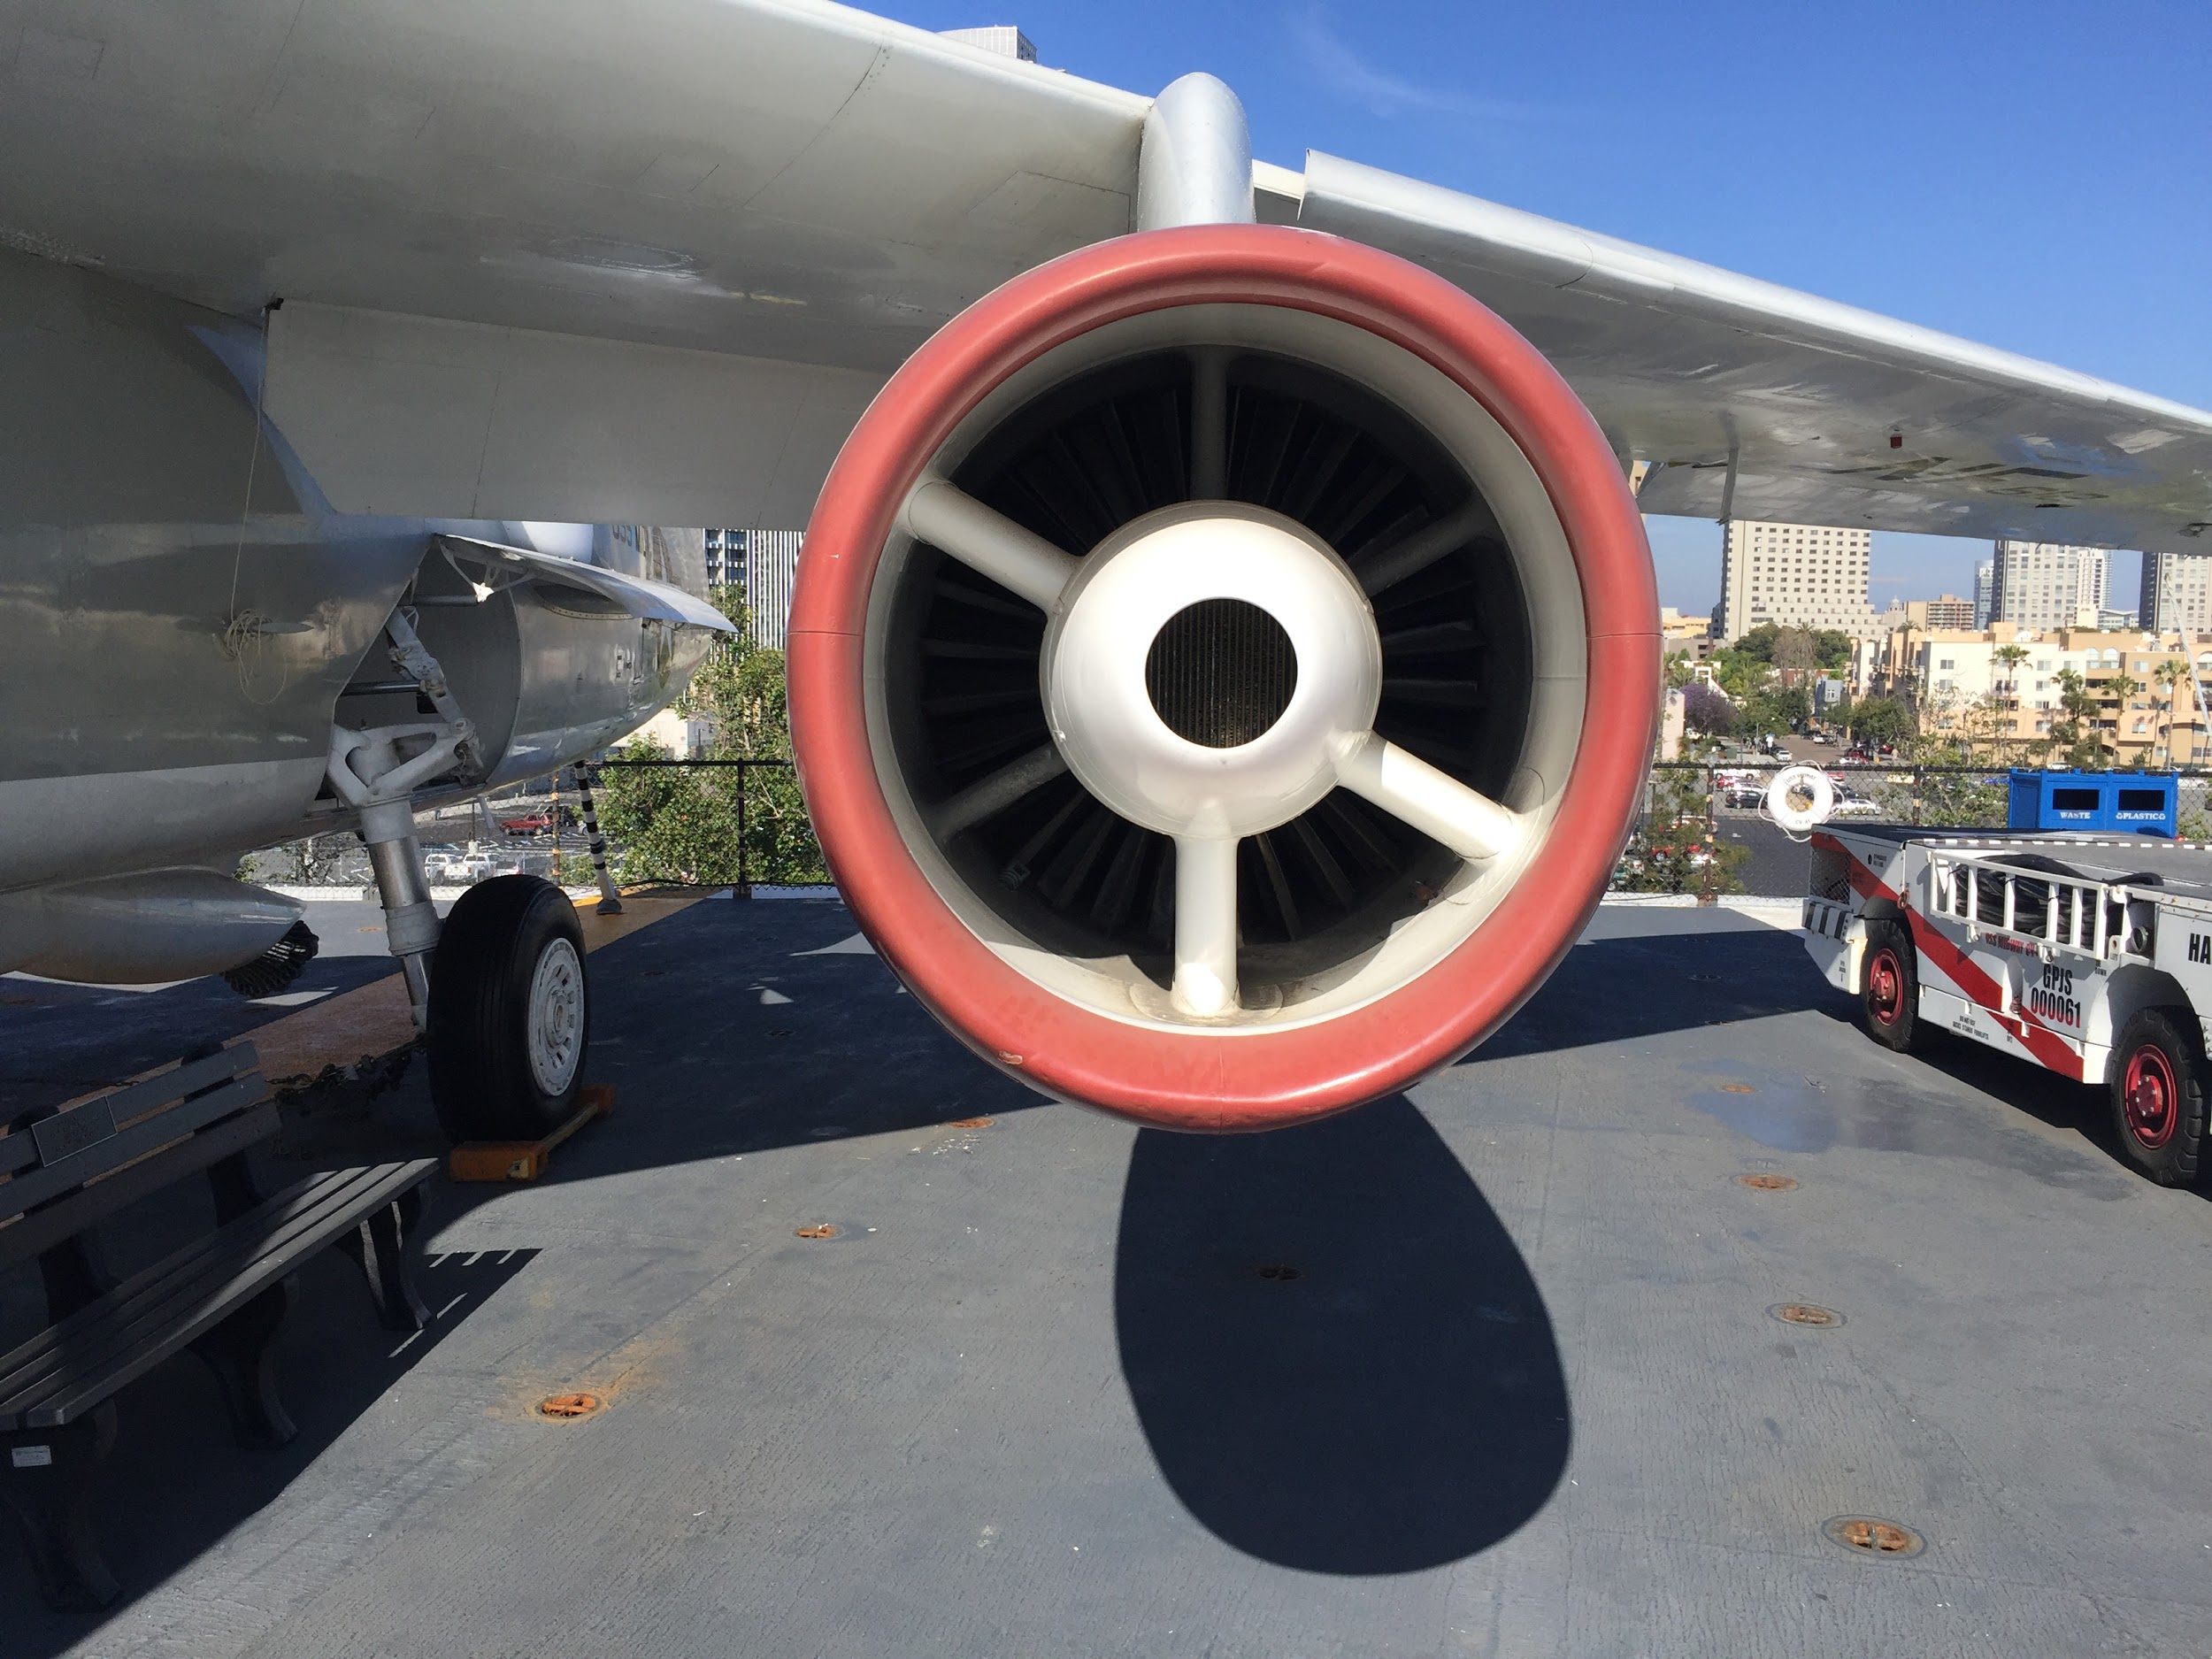
Do Not Stand Here

Slide 55
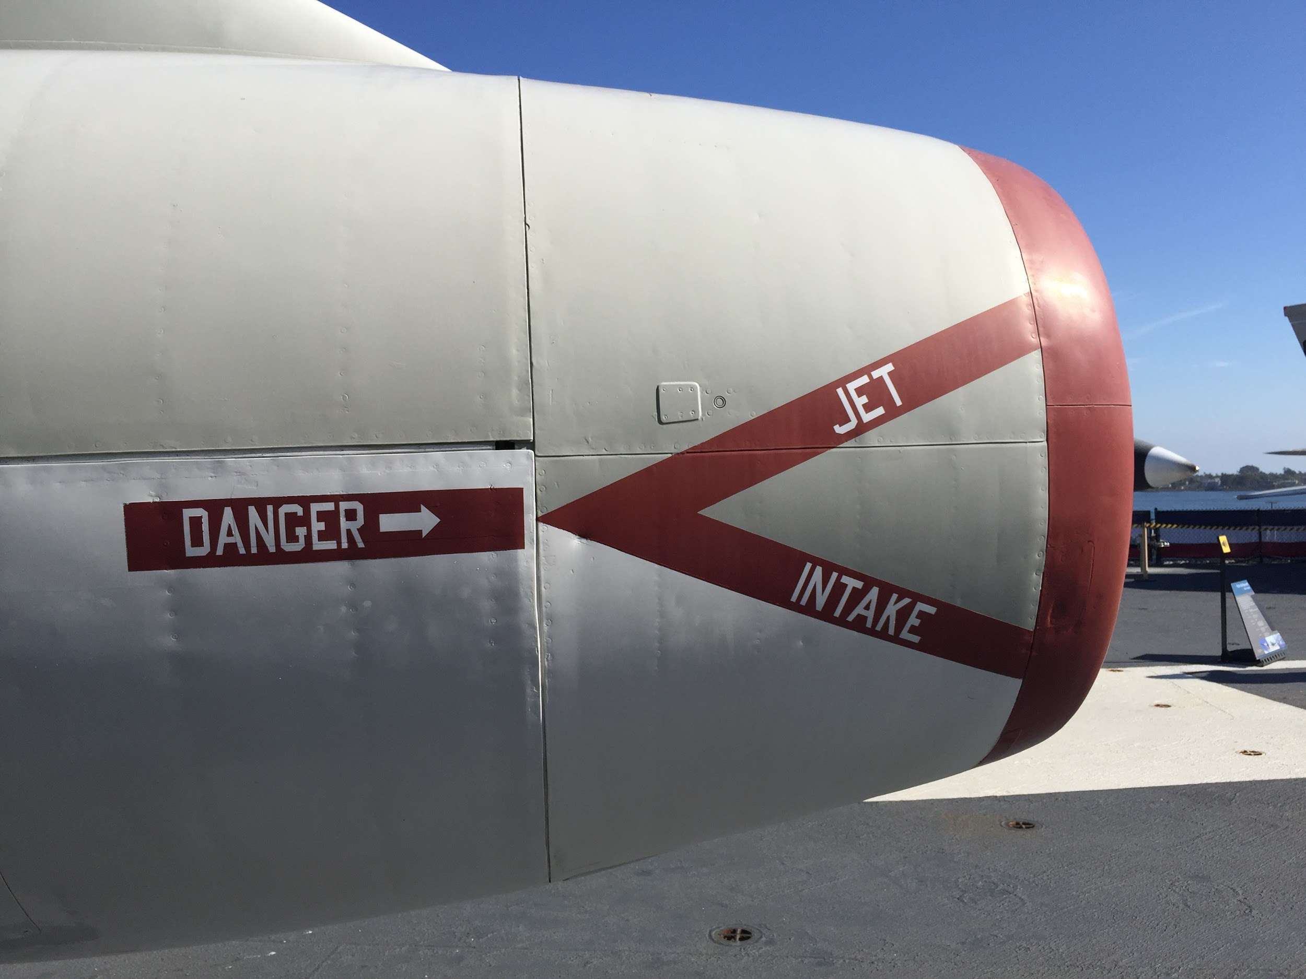
It is Dangerous!!!

Slide 56
Identity Onboarding with Banner
Overview/mission of the Working Group
Integrate Banner with TIER tool chain
Look at what attributes are pulled from Banner by various schools
Evaluate TIER minimal person schema
What attributes should go to midPoint
What should go to Grouper
Look at methods to move data from Banner to TIER tools
Direct connect to Banner database
Banner General API
BEIS
Ethos
How can the community benefit from our work?
9 of the 10 CSP schools are using Banner, guidance on integration with TIER would be helpful

Slide 57
Identity Onboarding with Banner
Key work completed
Developed a POC for Ethos
Work underway
Evaluate attributes that are pulled from Banner
Observations so far:
We have all found very different ways to do the same thing
Oregon State has an extensive set of PL/SQL scripts that populate a table used by existing IDM
Mines uses BEIS and Banner general API
Rice and Lafayette have identified a number of attributes that they pull via SQL

Slide 58
Identity Onboarding with Banner
Planned work
Develop a statement of work for Ethos and/or a connID connector to midPoint
Develop guidance for extended attribute definition in midPoint

Slide 59
Identity Onboarding with Banner
Links to resources (blogs, wiki, artifacts, etc)
https://spaces.internet2.edu/display/TIERCSP/Identity+Onboarding+with+Banner
https://docs.google.com/document/d/1kgDU6NoeC-oDGnqvU_4hvqsSdb30r2aymhGJZZJz_0M/edit
https://github.com/mbrookov/TIER_Ethos_midPoint_POC.git
How to get involved
Join calls, help sort through attributes
Write a POC for BEIS
Contact information
Matt Brookover, Colorado School of Mines, mbrookov@mines.edu

Slide 60
CSP Working Group Breakout Sessions
60 minutes

Slide 61
Closing Discussion
30 minutes

Slide 62
Closing Discussion
Milestones for TechEx
Report out from Working Groups
Deliverables (Any support needed?)
Campuses
All Hands on Deck
Case Studies and Project Plan Status
Artifacts
Program
Third Quarter Assessment completed
Final Report and Recommendations post TechEx
At TechEx
Final meeting Onsite
Presentations/Demos

Slide 63
TIER Campus Success Program
Thank You!
Additional Information: https://spaces.internet2.edu/display/TIERCSP/TIER+Campus+Success+Program+Home
PRESENTED BY:
TIER Working Groups, Subject Matter Experts, and members of the Campus Success Program
© 2018 Internet2

